Slide 1
Sprint #6 Presentation
Jamil Khan, Chaz Del Prato, Benjamin Seo, Christine Duong, Brandon Le, John Him

Slide 2
Updates
Management Plan
Gantt Chart
Burndown Chart
Project Tracking Matrix
Team Code Velocity
Sprint Retrospective
User Manual
Notes:
Jamil

Slide 3
Sprint Goals
Create UI for Rating System to Rate other players.
Connect Rating System to Database
Test Rating System
Create a User Manual
UI for Join an Event
Database for Joining Events
Testing Join Events
Create/Modify ML Data Set
Create/Modify a Model
Test Model Using Data Set
Research How to Implement the API
Notes:
Chaz

Slide 4
User Stories for This Sprint
As a Player:
I want to be able to use a user’s manual, so that I can understand how to use the application
I want to be able to see someone else’s profile, so that I can interact with others on the app”
As an app admin:
we want to be able to research how to implement the Google Maps API, so that we can use Google Maps with our app
Notes:
Brandon

Slide 5
Features in Data Sample
How many features are there in a data sample?
First Name, Last Name, Label, Basketball Played, Football Played, Soccer Played, Baseball Played, Tennis Played, Beach Volleyball Played, Indoor Volleyball Played, Racquetball Played, Rugby Played, Ice Hockey Played, Field Hockey Played
What is the source of the training data?
Self Generated Data through the use of SDGen and NPM Faker
For Recommendation System, The data is made to check if a user has played other sports besides the one they are labeled. 0 for no 1 for yes.
Notes:
Ben

Slide 6
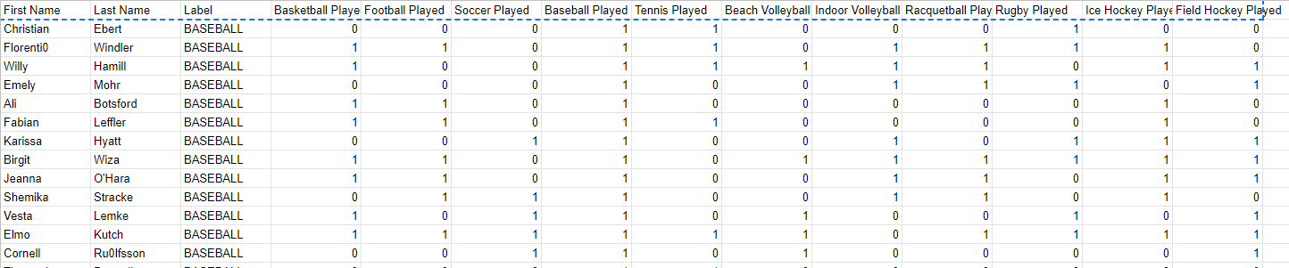
Features in Data Sample
Notes:
Ben

Slide 7
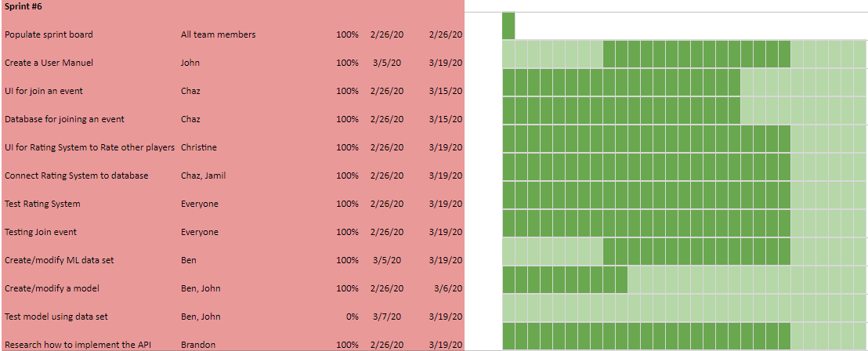
Gantt Chart
Notes:
Christine

Slide 8
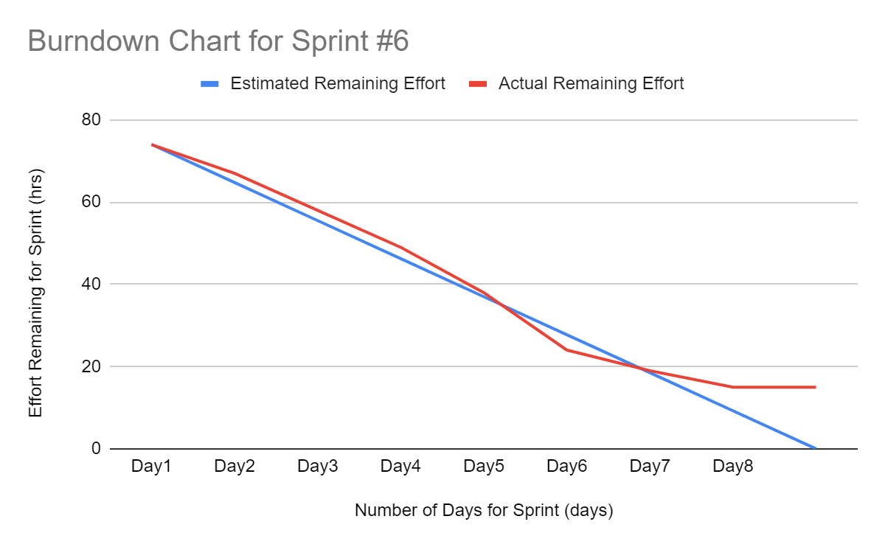
Burndown Curve
Notes:
John

Slide 9
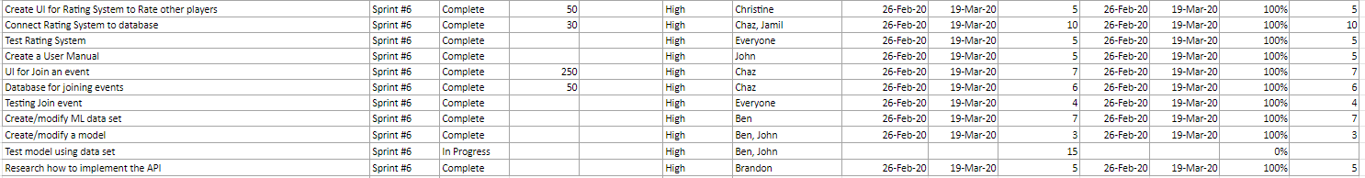
Project Planning Matrix
Notes:
Jamil

Slide 10
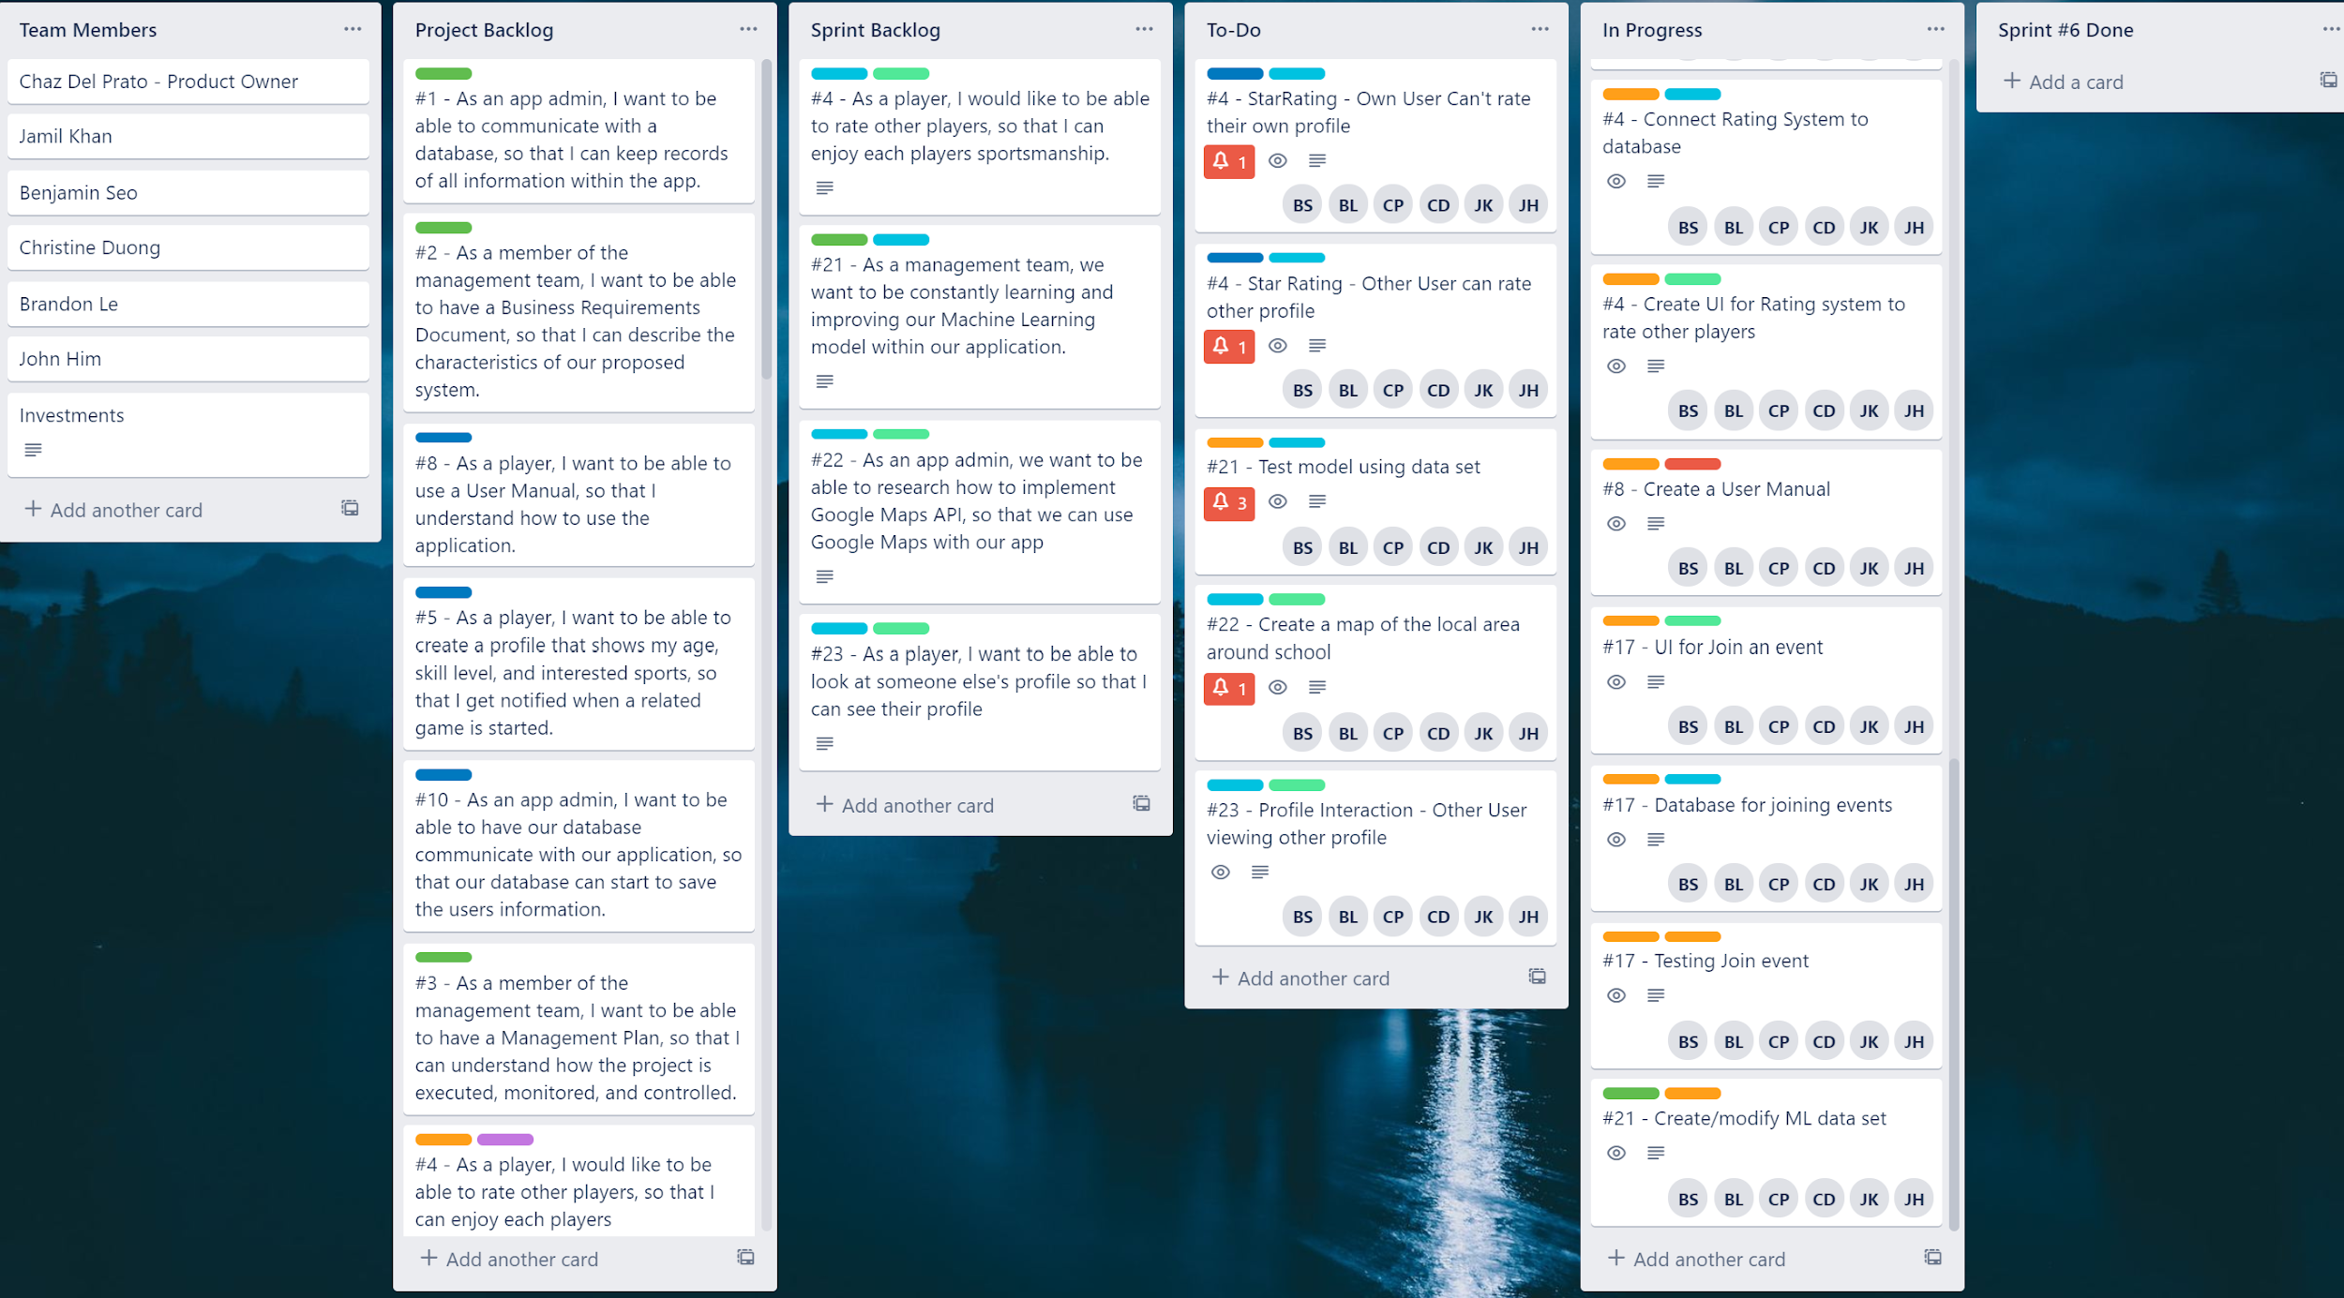
Sprint Board (Start)
Notes:
Chaz

Slide 11
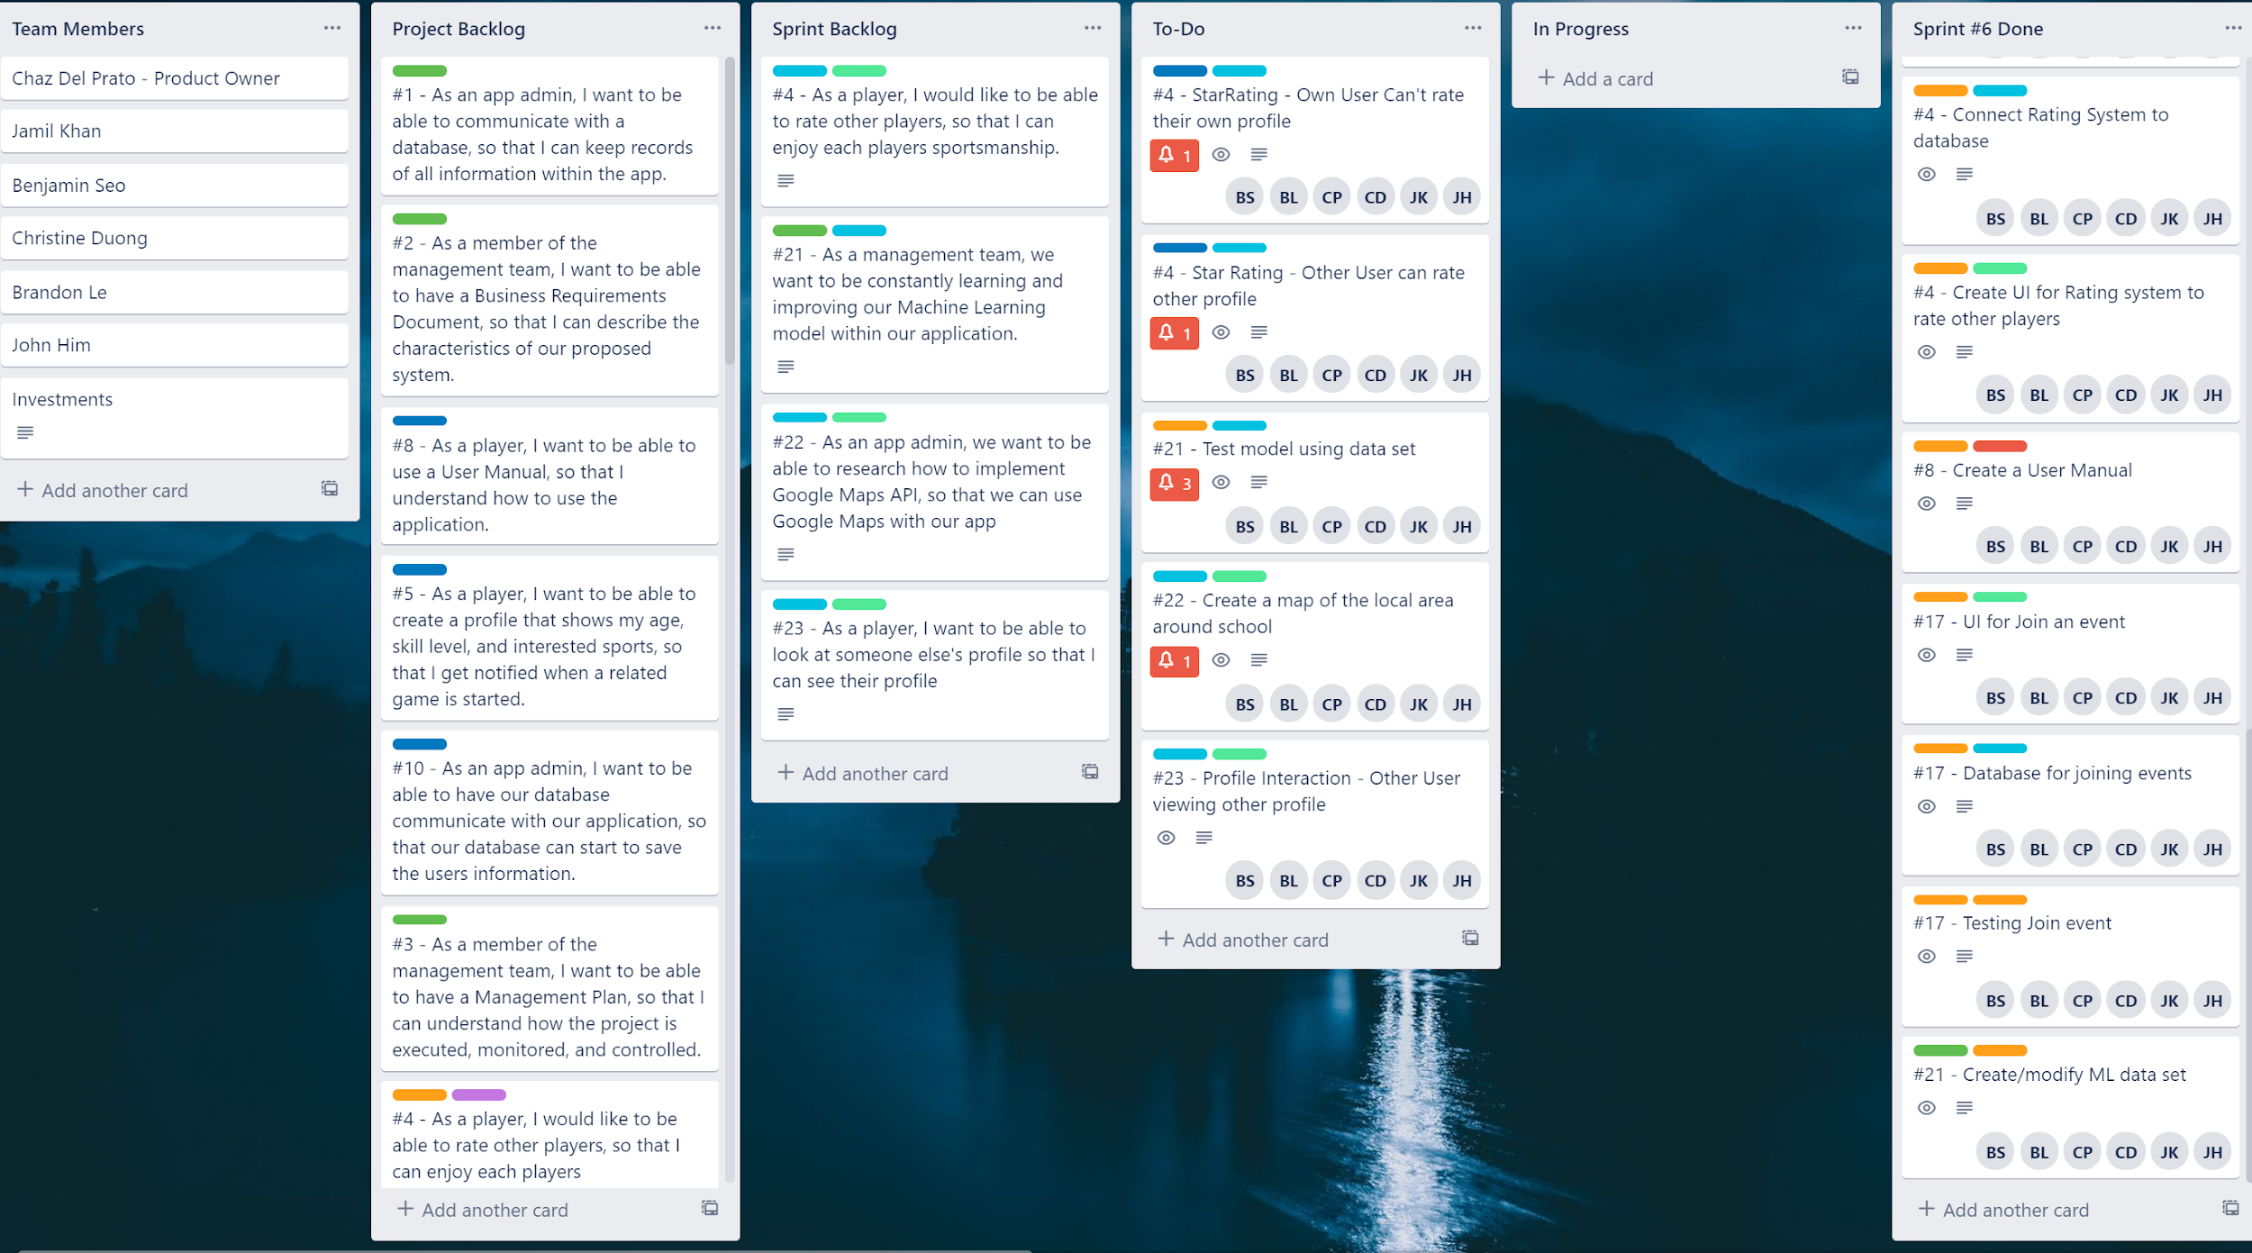
Sprint Board (End)
Notes:
Ben

Slide 12
User Features
Completed(13)
Create Account
Create Profile
Log in
Change Password
Log out
View Profile
Edit Profile
View Schedule
Create Event
Cancel Event
Leave Event
View Available Events
Join Event
In Progress(3)
Map Features
View Ratings
Leave Ratings

Slide 13
Sprint Retrospective
Our goal was to:
Create UI for Rating System to Rate other players.
Connect Rating System to Database
Test Rating System
Create a User Manual
UI for Join an Event
Database for Joining Events
Testing Join Events
Create/Modify ML Data Set
Create/Modify a Model
Test Model Using Data Set
Research How to Implement the API
Notes:
Christine

Slide 14
Sprint Retrospective
Our team’s total velocity is :
4 hours x 3 weeks x 6 members = 72 hours (story points).
We were not able to meet our sprint goal.
Adjusting to working from home and not having face-to-face contact
Fixed other problems that popped up.
Added other features that was not part of our sprint goal.
Notes:
Jamil

Slide 15
Sprint Retrospective
Current hours worked:
57 (hours) Story Points Finished
30+ hours on additional non story Points worked on.
Burndown Chart Analysis:
Stay almost in track throughout, but digressed to fix other issues or add other features.
Notes:
Brandon

Slide 16
Sprint Retrospective
Team velocity for next sprint:
Keep the team velocity to 90 hours.
Focus more on Machine Learning, Google Maps API implementation, and slightly fix small issues.
Notes:
Christine

Slide 17
Code Evaluation
User Stories Implemented
For Sprint #6, we implemented:
Users can edit their profile
Users can join an event
Users can leave an event
Users can host an event
Notes:
John

Slide 18
Code Evaluation
Code Function
Create account with their own email.
Sign in with their own account.
Create/join an event
Leave/Cancel an event
View their Own Profile.
Logout.
Sign in with their own account.
Create/Edit Profile
Notes:
John

Slide 19
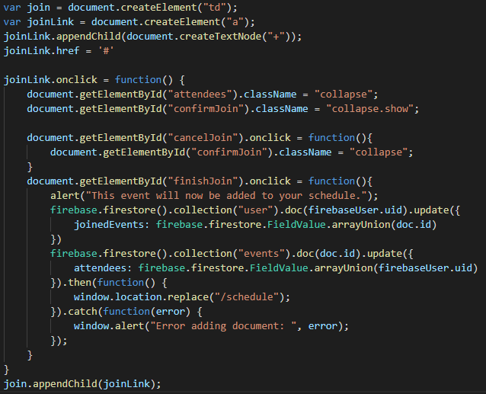
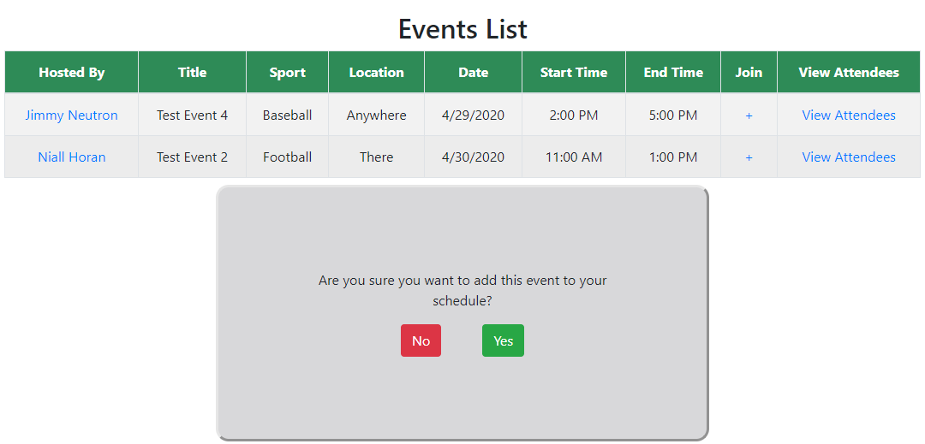
Code Review
Join Event

Slide 20
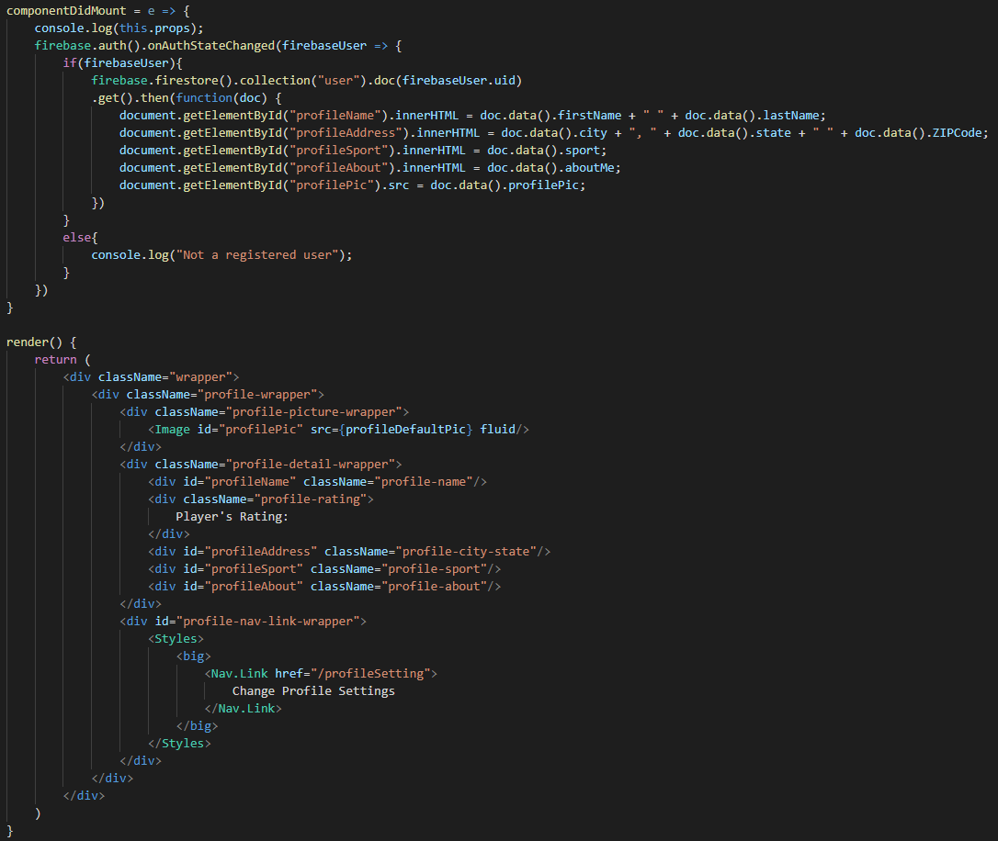
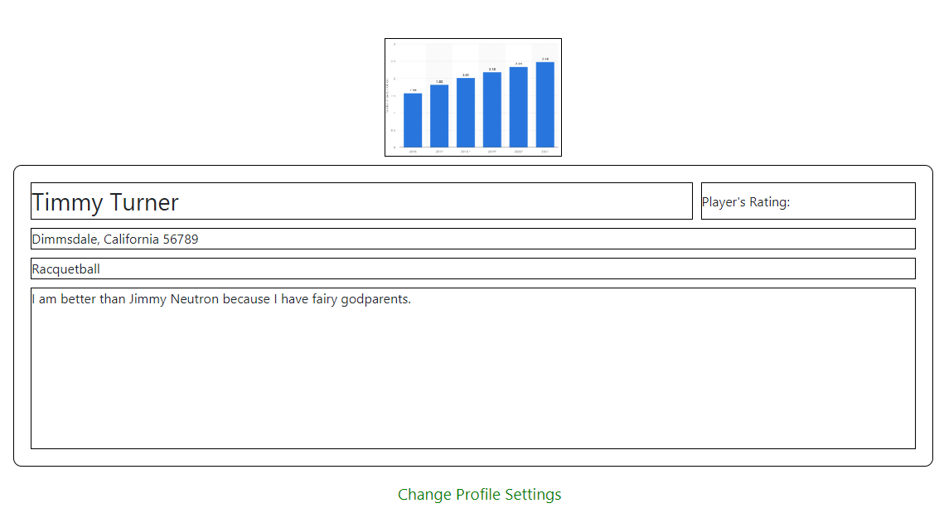
Code Review
View Your Profile

Slide 21
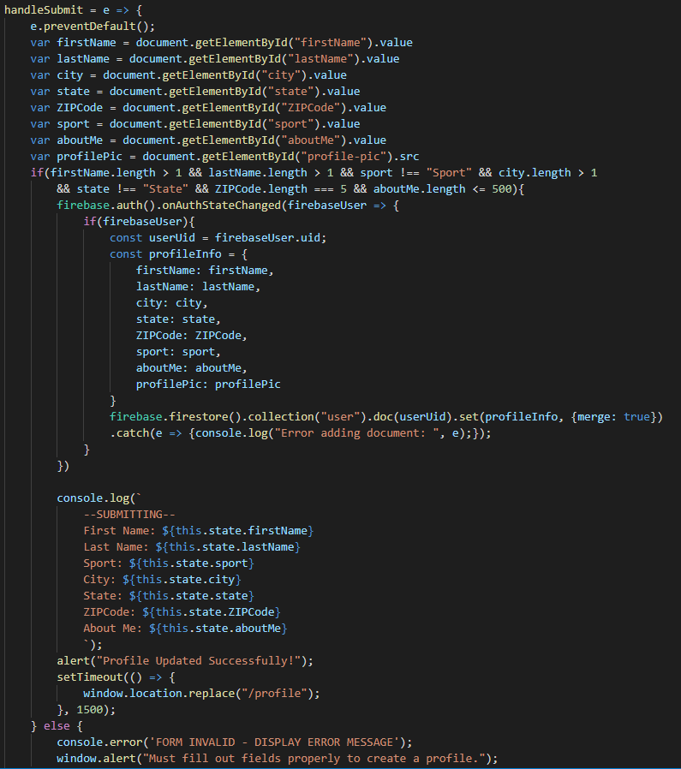
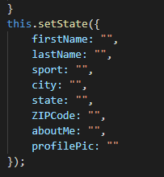
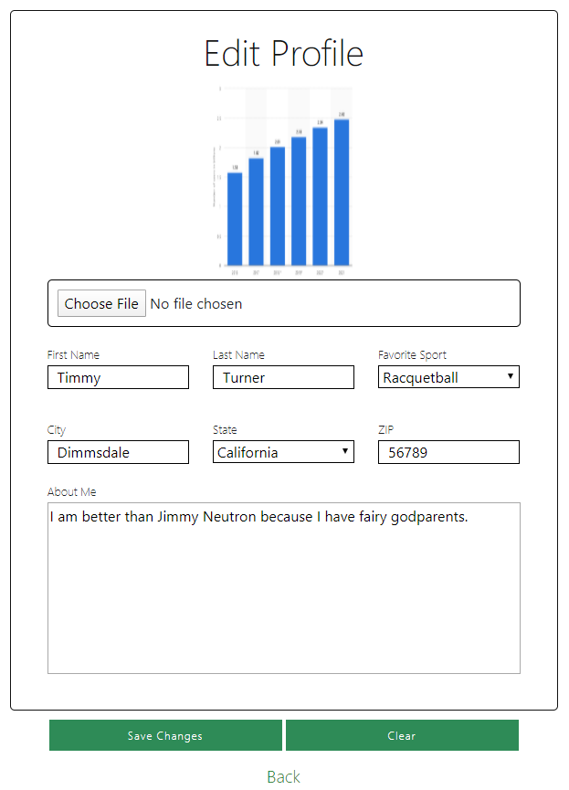
Code Review
Edit Profile

Slide 22
Application Review
https://pick-up-sportz-89c6e.firebaseapp.com/

